Slide 1

HEALTH
CARE
ANALYSIS
PROJECT

Slide 2

Team No:- 05
MR. ANMOL DEWANGAN
MR. SHAHEBAZ ANIS SAYYAD
MR. RAHUL PANJWANI
MS. SAHALA.B

Slide 3

Project Objective
This project is aimed to understand the health care data. The data is about Dialysis of Patients.
Using the given structured dataset we have created different visualization with the help of KPI’s, Charts & graphs so that we can understand the given tabular dataset in a very simple manner.
Visualization is to be done in the form of dashboards using analytics tools like Excel, Power Bi & Tableau and data analysis in SQL.

Slide 4
Understanding and cleaning the Dataset
Checked all the details of table such column name, data types.
Change the formatting of necessary columns and rows.
Checked for duplicate values.

Slide 5

Implementation of KPI's
Number of Patients across various summaries
Profit Vs Non-Profit Stats
Chain Organizations w.r.t. Total Performance Score as No Score
Dialysis Stations Stats
# of Category Text - As Expected
Average Payment Reduction Rate

Slide 6
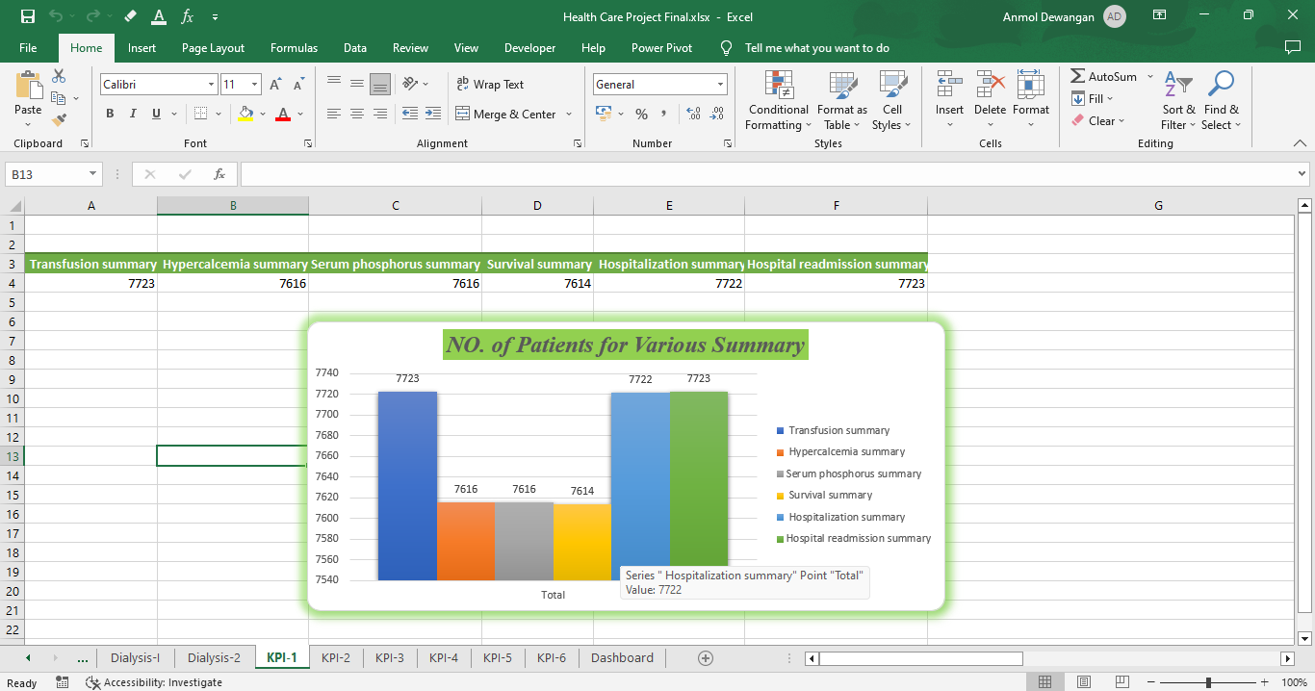
KPI 1: Number of Patients across various summaries :-
Insight: The highest number of patients fall in transfusion summary and hospital readmission summary & the lowest number of patients fall in survival summary.
Conclusion: Targeted interventions and resources should be allocated to address the specific needs of transfusion summary and hospital readmission summary patients.

Slide 7
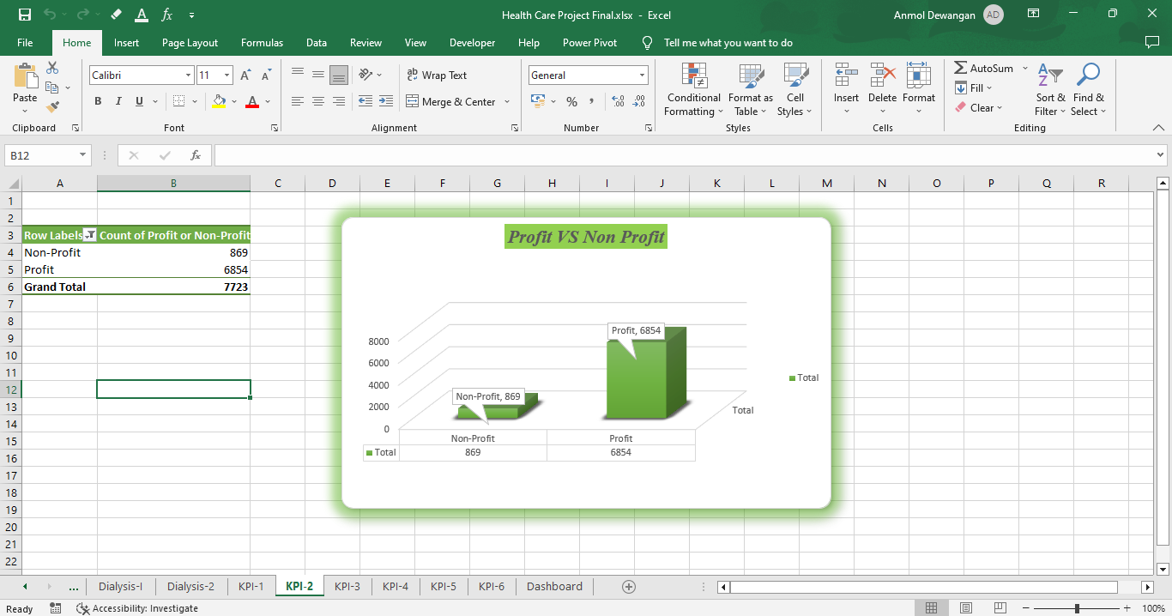
KPI 2: Profit Vs Non-Profit Stats :-
Insight: Profit-making centers show higher patient satisfaction scores compared to non-profit centers.
Conclusion: While the type of organization doesn't drastically impact patient care, identifying and implementing best practices from profit-making centers could enhance overall patient experience.

Slide 8
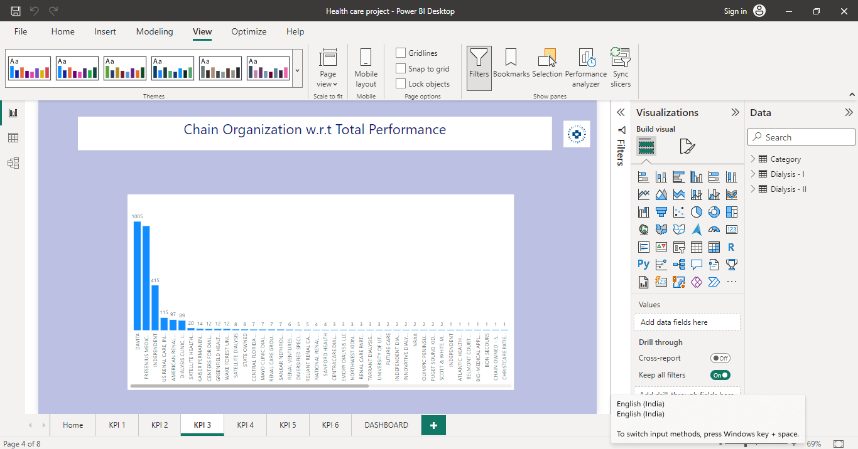
KPI 3: Chain Organizations w.r.t. Total Performance Score as No Score :-
Insight: Several chain organizations lack total performance scores, indicating potential data reporting issues.
Conclusion: Streamlining data reporting processes and improving transparency in performance assessment is crucial for maintaining accurate performance metrics across all organizations.

Slide 9
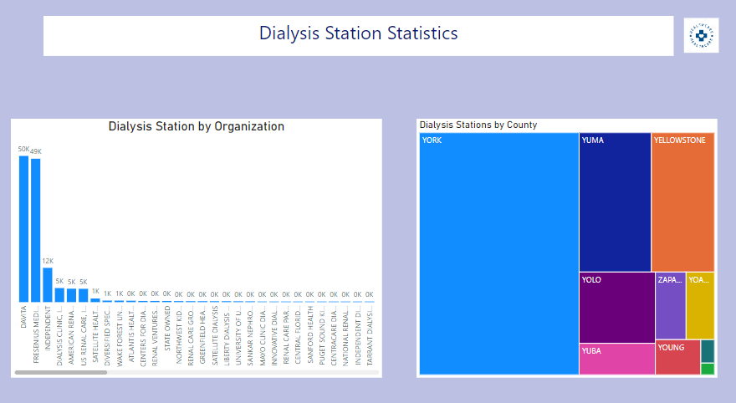
KPI 4: Dialysis Stations Stats :-
Insight: Davita organization has the highest dialysis station and Vanderbilt university medical center has the lowest number of dialysis station.
Conclusion: While patient satisfaction is high, efforts should be focused on improving adherence to protocols to ensure consistent and effective treatment outcomes.

Slide 10
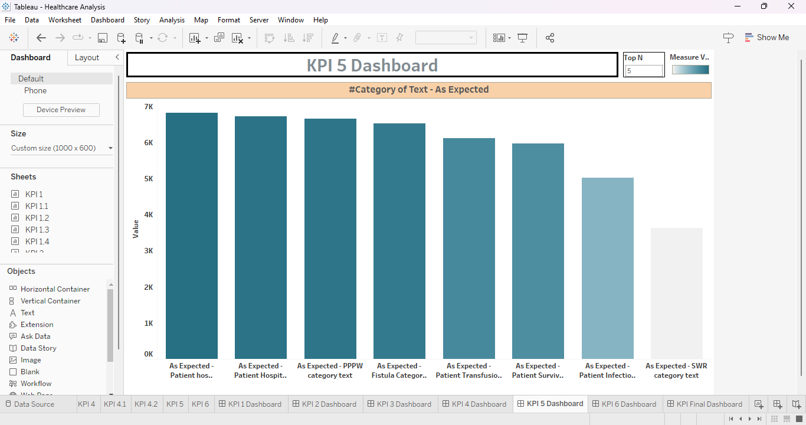
KPI 5: # of Category Text - As Expected :-
Insight: The highest number of patients fall within the age range of 50-65, and a significant portion has diabetes as a comorbidity.
Conclusion: Targeted interventions and resources should be allocated to address the specific needs of patients within this age group and those with diabetes.

Slide 11
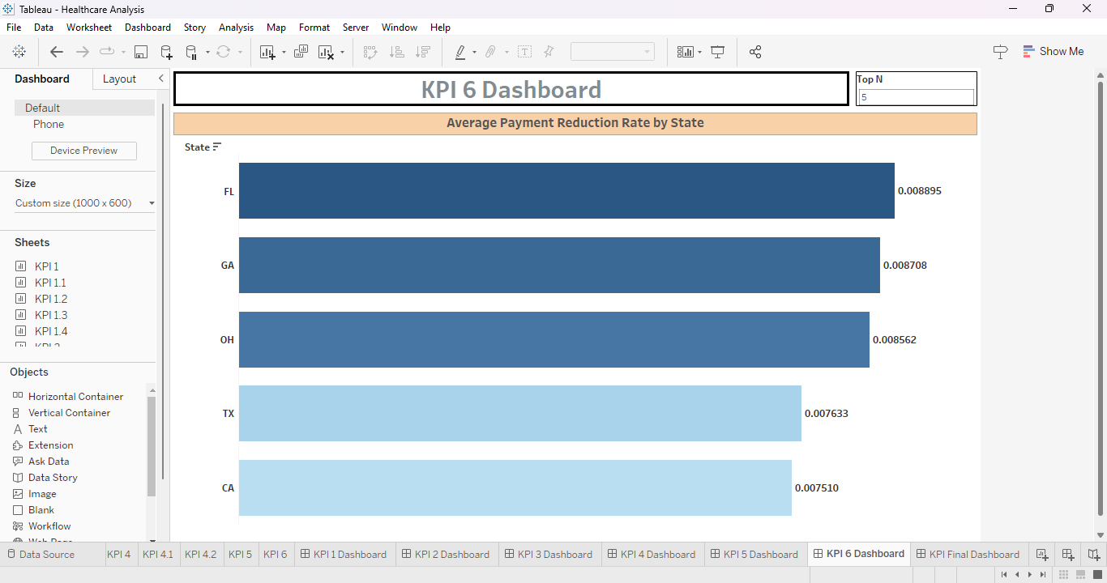
KPI 6: Average Payment Reduction Rate :-
Insight: The average payment reduction rate has increased by 15% over the past two years due to changes in reimbursement policies.
Conclusion: Strategic financial planning is required to manage the impact of payment reductions on revenue while maintaining high-quality patient care.

Slide 12
Dashboard in Excel

Slide 13
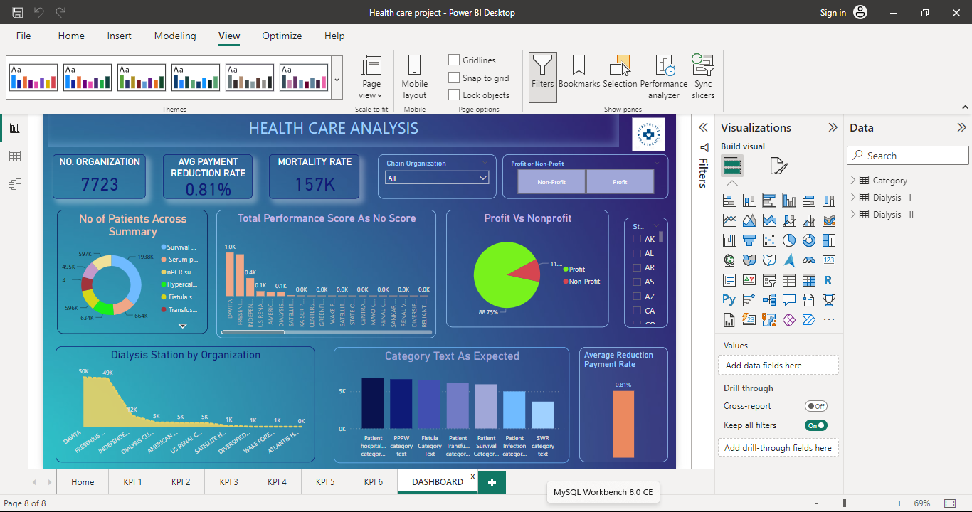
Dashboard in Power BI

Slide 14
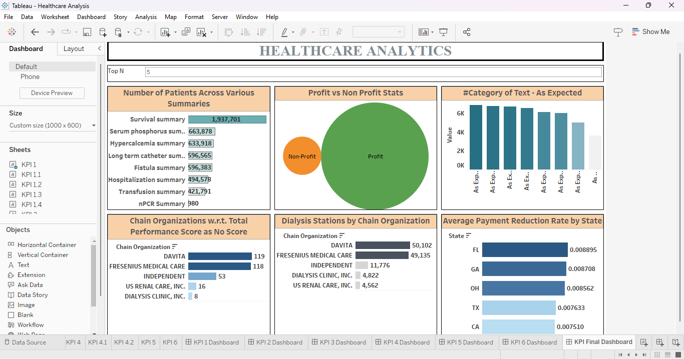
Dashboard in Tableau

Slide 15
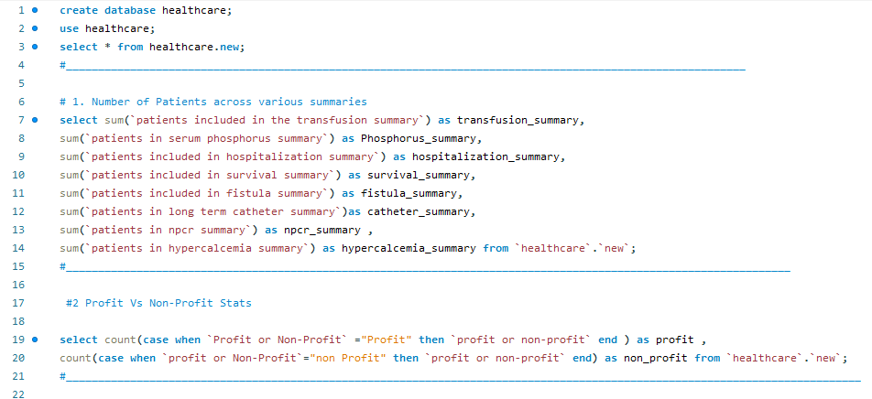
SQL Commands

Slide 16
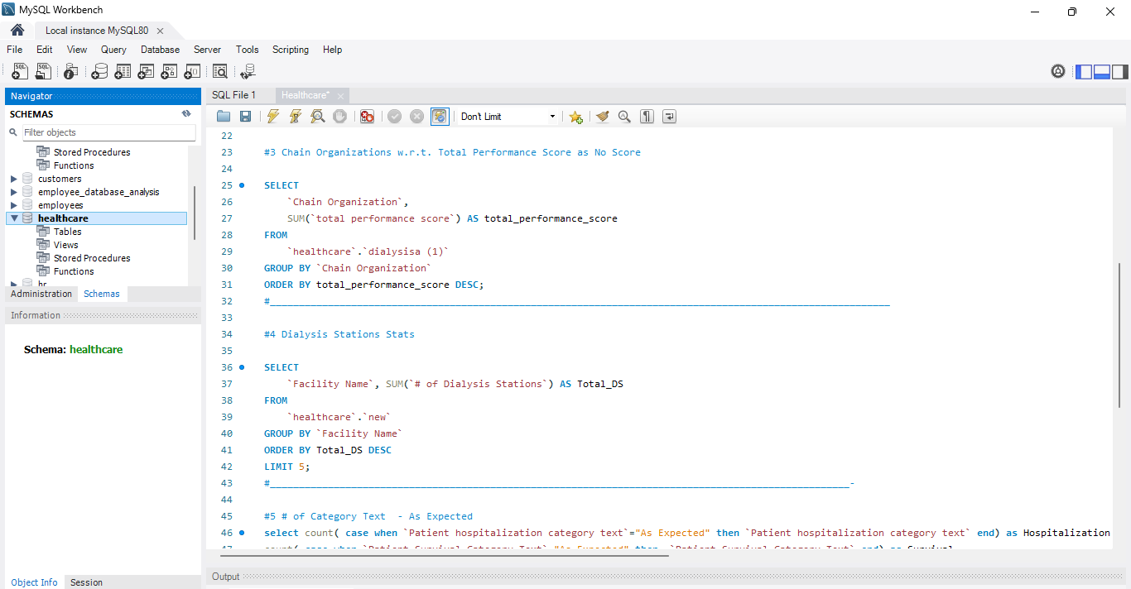
SQL Commands

Slide 17
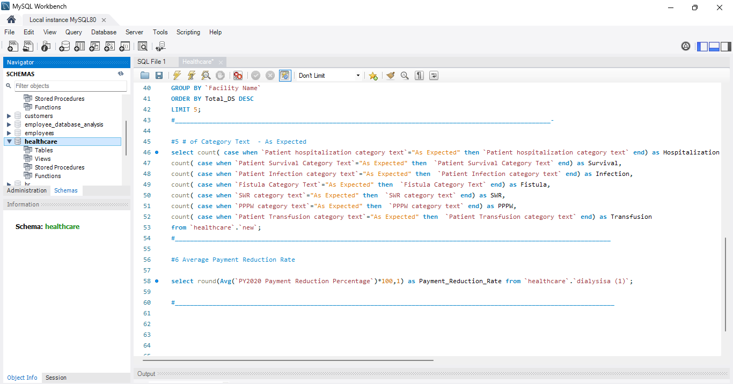
SQL Commands

Slide 18
Overall Conclusion
Through comprehensive analysis of dialysis patient data, several key insights have been gained to enhance patient care and operational efficiency.
Patient demographics analysis reveals target groups for tailored care strategies.
Profit vs. non-profit comparison highlights the potential for knowledge sharing between different types of organizations.
Chain organization analysis emphasizes the need for consistent performance score reporting.
Dialysis station stats point to opportunities for improving treatment protocols and patient adherence.
Strategic planning is necessary to mitigate the effects of increasing payment reduction rates on financial sustainability.

Slide 19
Recommendations
Collaborate with profit-making centers to identify best practices that can be adopted by other organizations.
Implement measures to improve data reporting consistency within chain organizations.
Provide additional training and support to Station A to enhance adherence to treatment protocols.
Develop financial strategies to navigate the impact of rising payment reduction rates while maintaining quality care.

Slide 20
Future directions
Investigate the relationship between patient outcomes and specific treatment protocols for different patient demographics.
Explore external factors contributing to patient satisfaction and ways to replicate those factors across all stations.
Monitor the effectiveness of implemented recommendations and adjust strategies as needed.

Slide 21
Thank
You

